Slide 1
The Dalles Failing Spillway
Bob Cordie
Biologist
The Dalles Dam

Slide 2
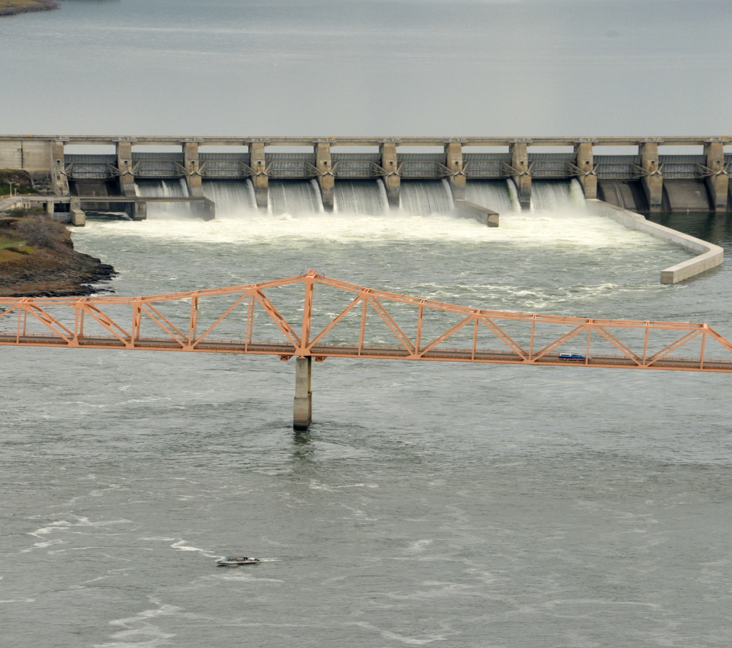
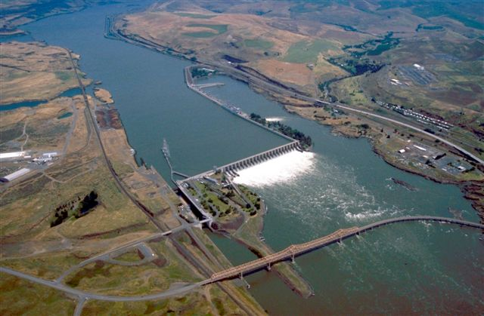
The Dalles Spillway

Slide 3
Spillway History
1995-1999 Spillway testing for juvenile passage 30% and 64% river flow
2000-2003 Operate 40% of river flow spill using bays 1-17
2004 Construction of bay 6/7 spillwall
2005 Discover failing wire rope. Use of 4’, 5’, 6’ and 8’ pennants on spillgates 3 - 6
2006 Replaced wire rope and drums for spillbays 1-9
2004-2009 Operate 40% spill trying to maintain north of 6/7 spillwall
2010 Construction of bay 8/9 extended spillwall
2010-2017 Operate 40% spill trying to maintain north of 8/9 spillwall
2012 Tagged out bays with deficiencies
2013 Project evaluation of spillway and deficiencies
2016 Comprehensive assessment of Lower Columbia Spillways starts
2018 Bathymetry test finds rock pile below spillbay 10.
2019 Operate according to flex spill guidelines

Slide 4
Spillgates Out of Service
Bay 9 – seized trunnion pin
Bay 10,11,13 – wire rope
Bay 14 – unknown
Bay 16,18,19 – structural deformation
Bay 23 – apron undercutting

Slide 5
COST ESTIMATES
Crane Rehab E&D -.3M
Crane Rehab - 10.6M
Bays1-9 Rehab – 28.8M
Bay10-23Rehab -45.8M
Power Upgrade - .9M
Controls Upgrade– 5.2M
Grand Total – 102M
FY25 Non-Routine Budget Submission

Slide 6
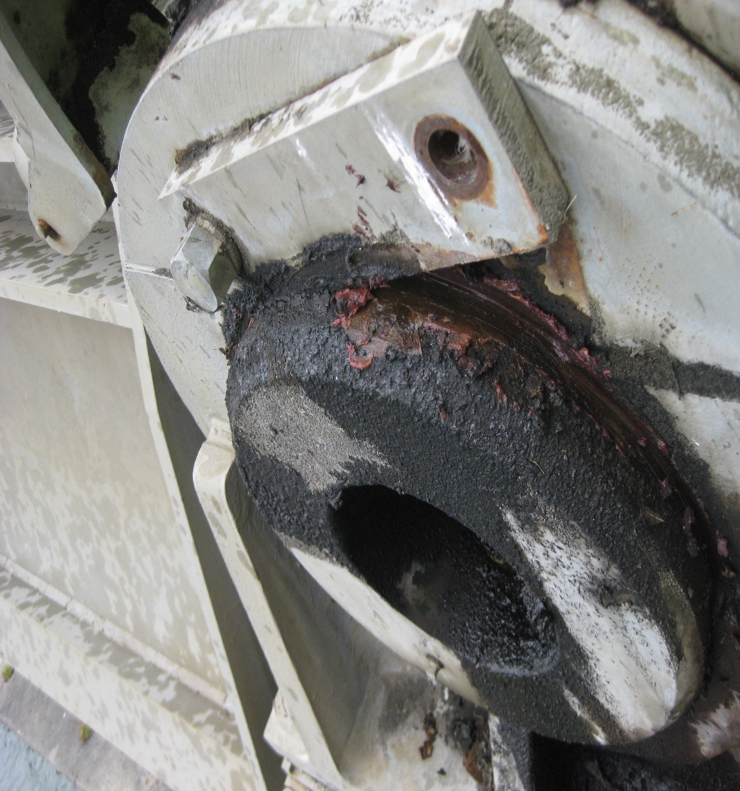
Infamous Bay 9 Trunnion Pin

Slide 7
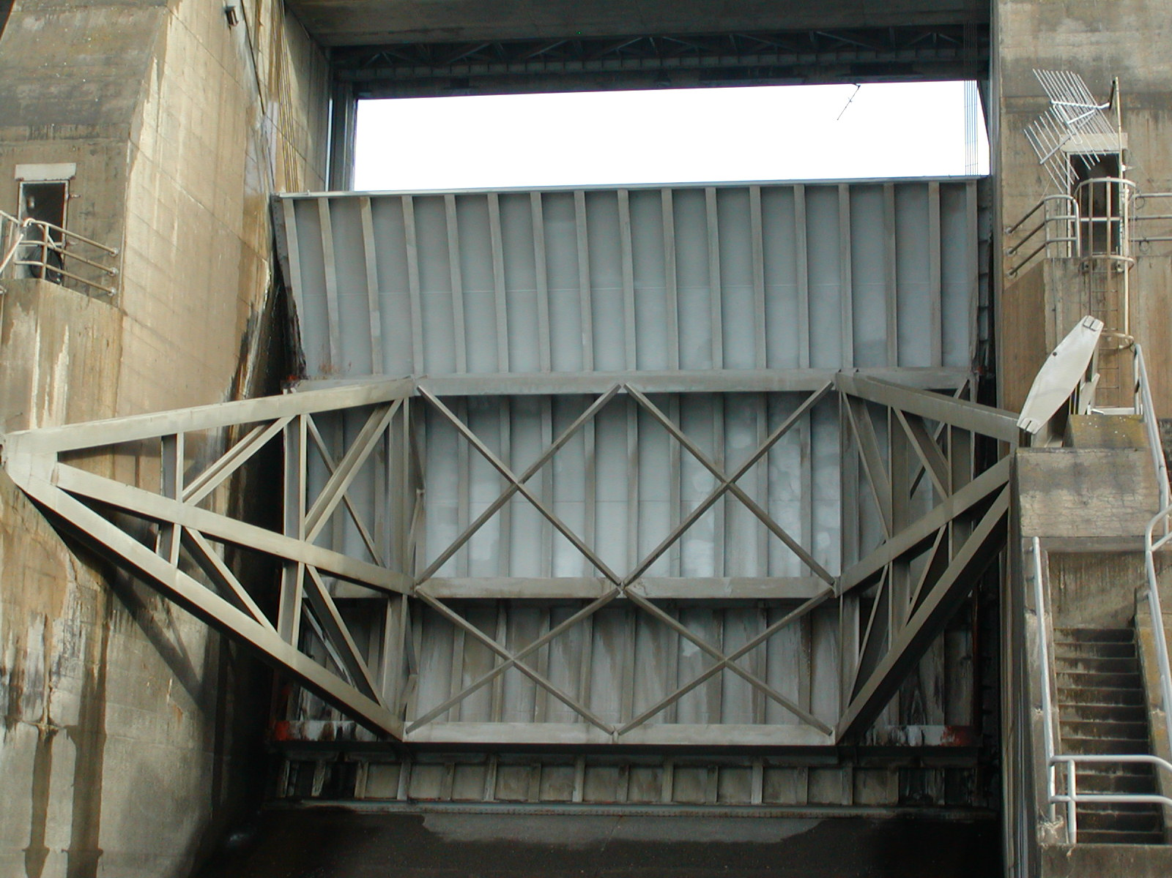
Bent Struts

Slide 8
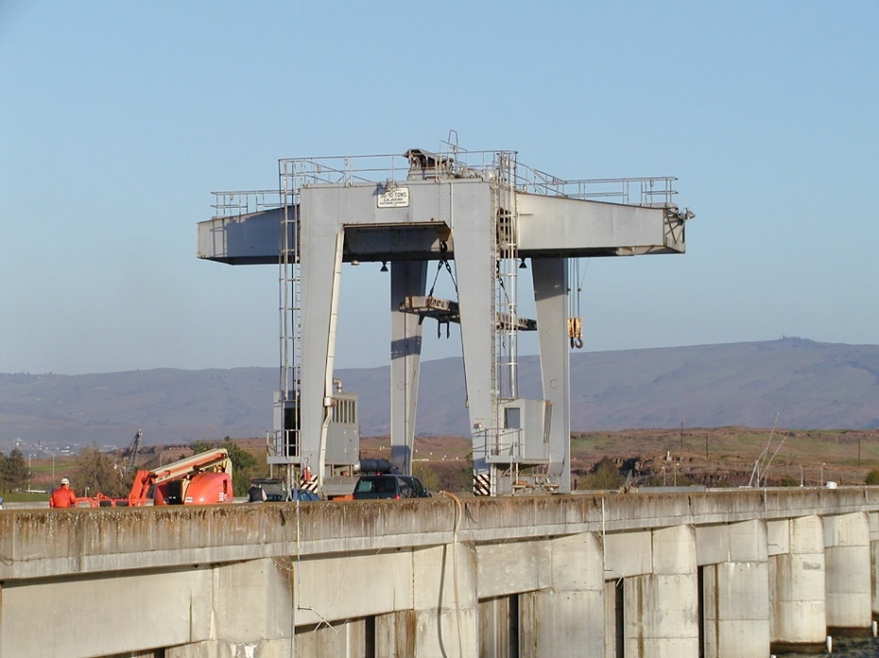
Failing Crane

